Slide 1
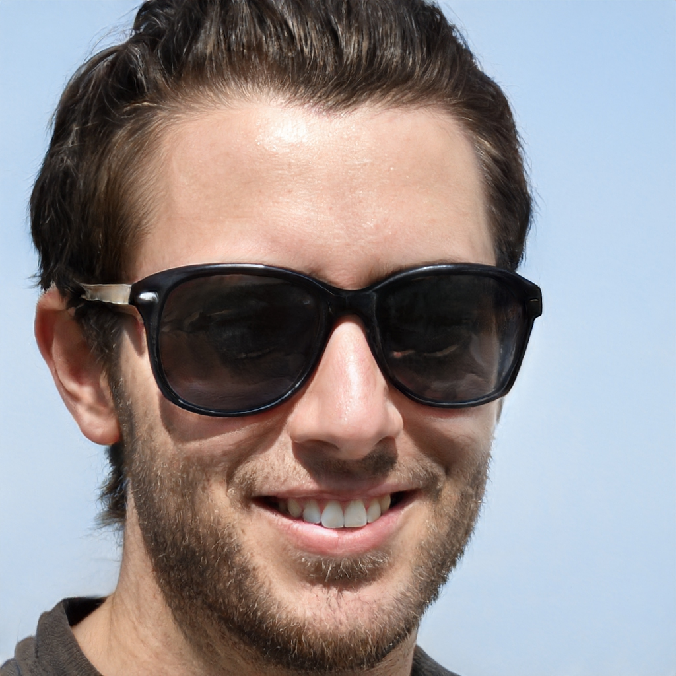
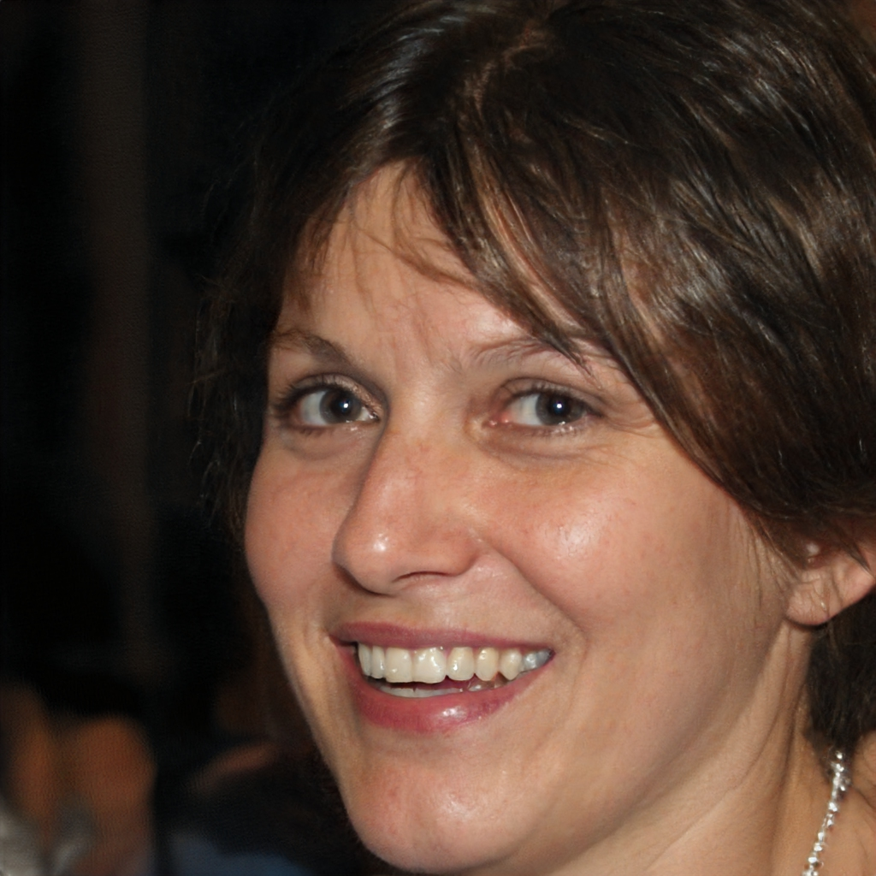

Slide 2


Person Surname
Person’s Job

Slide 3

Person Surname
Person’s Job

Slide 4
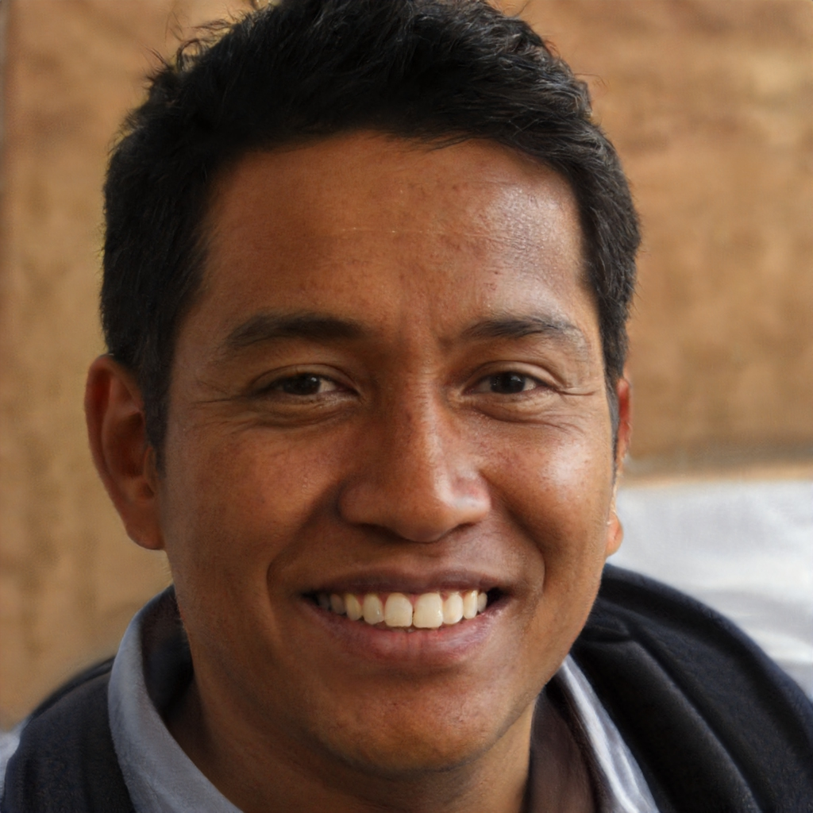
Person Surname
Person’s Job

Slide 5
A celebration of those who maintain different parts of our world, and how they do it, recognizing the often hidden work they do to keep our world going
Person Surname
Person’s Job

Slide 6
A celebration of those who maintain different parts of our world, and how they do it, recognizing the often hidden work they do to keep our world going
Person Surname
Person’s Job

Slide 7
A celebration of those who maintain different parts of our world, and how they do it, recognizing the often hidden work they do to keep our world going
Person Surname
Person’s Job

Slide 8
A celebration of those who maintain different parts of our world, and how they do it, recognizing the often hidden work they do to keep our world going
Person Surname
Person’s Job

Slide 9

28th
September
20:45
Speaker’s Name
Speaker’s Job

Slide 10

28th
September
20:45
Speaker’s Name
Speaker’s Job

Slide 11

28th
September
20:45
Speaker’s Name
Speaker’s Job

